Slide 1
Employee Income Levels & Fair Labor Practices: A Data Analysis Report
Prepared for: HR Manager
Prepared by: Ibrahim Richard (Business Analyst)
Date: July 21, 2025.

Slide 2
Introduction – Our Commitment to Fair Labor Practices
Good Day. This report summarizes key demographic and income data for our 474 employees. Understanding this data is crucial to ensuring we maintain compliance with fair labor practices within the furniture manufacturing industry and to support our strategic objective of fair compensation.

Slide 3
Employee Demographic Profile – Gender Distribution
Understanding our workforce composition is the first step.
Total Employees: 474
Male Employees: 258
Female Employees: 216
Gender Distribution:
Male: 474258 ​= 54.43%
Female: 474216​ = 45.57%

Slide 4
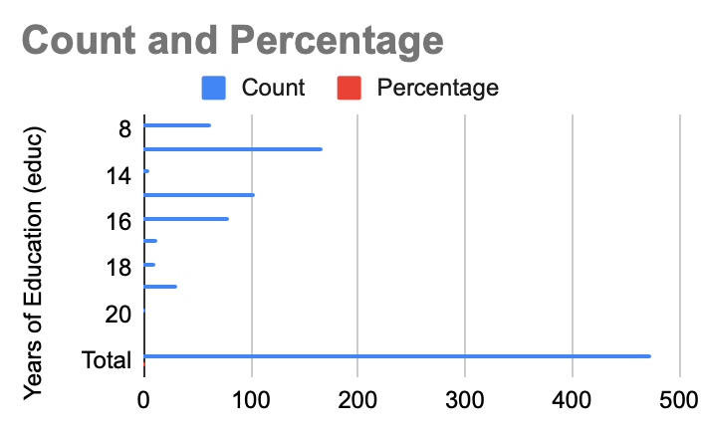
Employee Demographic Profile – Education Levels
Education levels across our workforce provide insights into our human capital. The 'educ' column represents years of education.
Year Of Education | Count | Percentage
8 | 63 | 13.29%
12 | 167 | 35.23%
14 | 6 | 1.27%
15 | 104 | 21.94%
16 | 79 | 16.67%
17 | 12 | 2.53%
18 | 10 | 2.11%
19 | 32 | 6.75%
20 | 1 | 0.21%
21 | 0 | 0.00%
Total | 474 | 100.00%

Slide 5
Employee Demographic Profile – Tenure with the Company
Employee tenure, derived from the 'jobtime' variable (assuming it's in months), indicates stability and experience within our organization.
Minimum Tenure: 2 months (0.17 years)
Maximum Tenure: 98 months (8.17 years)
Average Tenure: 76.84 months = 6.40 years

Slide 6
Employee Demographic Profile – Minority Status
Promoting diversity is a key aspect of fair labor practices. The 'minority' variable indicates minority status (1 for minority, 0 for non-minority).
Minority Employees: 80
Non-Minority Employees: 394
Minority Status Distribution:
Minority: 80/474​ = 16.88%
Non-Minority: 394/474 = 83.12%

Slide 7
Employee Income Levels – Overall Salary Statistics
Our company's compensation structure, based on current salary data:
Mean Salary (Average): The average salary across all employees.
  Formula: Mean=Total Employees/ ∑Salaries​
  Result: $34,019.57
Median Salary: The middle salary value when all salaries are ordered from lowest to highest.
  Method: Sort all salaries and find the middle value.
  Result: $28,875.00
Mode Salary: The most frequently occurring salary value.
  Method: Identify the salary value with the highest frequency.
  Result: $27,450.00 (appears 5 times)
Standard Deviation: Measures the typical spread or variation of salaries from the average.
  Concept: Average distance of data points from the Mean.
  Result: $17,075.66
Variance: A measure of the overall spread of salaries, calculated as the square of the standard deviation.
  Formula: Variance=(Standard Deviation)2
  Result: $291,570,229.00

Slide 8
Employee Income Levels – Salary by Gender
Breaking down salaries by gender is crucial for assessing pay equity.
Mean Salary - Male Employees: $ \text{Mean Male Salary} = $37,846.12
Mean Salary - Female Employees: $ \text{Mean Female Salary} = $26,881.37
Initial Observation: There is a noticeable difference in mean salaries between male and female employees. Further investigation, considering factors like job category, experience, and education, would be required to understand the reasons behind this gap and ensure fair practices.

Slide 9
Understanding Industry Benchmarks – Statistical Concepts Explained
To compare our company's income levels with the industry average, we need to understand a few statistical concepts.
Margin of Error (ME): This is the "plus or minus" figure when you hear a survey result. It tells us how much the sample result (e.g., average income from our research) might differ from the true population average. A smaller margin of error means more precision.
Confidence Interval (CI): This is a range of values within which we are confident the true population average lies. For example, a 95% confidence interval means if we were to repeat our research many times, 95% of those intervals would contain the true population average.
Sample Size Determination: This refers to how many individuals or data points are needed in a study to achieve a certain level of precision (margin of error) with a desired level of confidence.

Slide 10
Industry Income Analysis – Margin of Error and Confidence Interval
Using provided industry data to estimate average income:
Industry Sample Mean (xˉ): $34,208.00
Industry Sample Standard Deviation (s): $17,629.00
Industry Sample Size (n): 380
95% Confidence Level: Z-score ≈1.96
1. Calculate Margin of Error (ME):
Formula: ME=Z× n​/ (square) s​
Calculation: ME=1.96× (square) 380 / $17,629.00​
ME=1.96×$904.34 $ \mathbf {ME \approx $1,772.51} $
2. Calculate 95% Confidence Interval (CI):
Formula: CI=xˉ±ME
Calculation: CI= $34,208.00 ± $1,772.51
CI Range: $32,435.49 to $35,980.51
Conclusion: We are 95% confident the true average industry income is between $32,435.49 and $35,980.51.

Slide 11
Industry Income Analysis – Required Sample Size for Different Confidence Levels
Let's determine the sample size needed if we wanted to achieve the same margin of error ($1,772.51) but with different confidence levels.
The formula for required sample size is: n = ME (square) / Z (square) ∗SD (square) ​
For 99% Confidence Interval: The Z-score for 99% CI is approximately 2.576.
$ n = \frac{(2.576)^2 * (17,629.00)^2}{($1,772.51)^2} $
n = (3141730.07) / 6.635776 ∗ 310761541​ n = 3141730.07 / 2062590635​ = 656.51
Required Sample Size = 657 employees
(This means to be 99% confident with the same precision, we would need a larger sample.)
For 90% Confidence Interval:
The Z-score for 90% CI is approximately 1.645.
$ n = \frac{(1.645)^2 * (17,629.00)^2}{($1,772.51)^2}$
N = (3141730.07) / 2.706025∗310761541​
N = 3141730.07 / 840907297​ = 267.66
Required Sample Size ≈268 employees (This means for a lower confidence level (less certainty), we would need a smaller sample to achieve the same precision.)

Slide 12
Conclusion – Company vs. Industry Income Levels
Let's compare our company's mean salary with the calculated industry average confidence interval.
Our Company's Mean Salary: $34,019.57
Industry Average 95% Confidence Interval: $32,435.49 to $35,980.51
Comparison:
Our company's mean salary of $34,019.57 falls squarely within the 95% confidence interval for the average income level in the furniture manufacturing industry (32,435.49 − $35,980.51).
Implication for Fair Labor Practices:
This indicates that, on average, our company's income level is comparable to the industry average. This is a positive sign regarding our commitment to fair labor practices in terms of overall compensation competitiveness.
Further Recommendations:
While the overall average is competitive, the analysis also highlighted:
Gender Pay Gap: The noticeable difference between male and female mean salaries warrants a deeper dive. We should analyze salary distributions within similar job categories, experience levels, and education to identify and address any potential disparities.
Detailed Job Category Analysis: Future analysis could segment salaries by 'jobcat' to ensure fairness within specific roles, especially considering category 3 (Manager) likely has much higher salaries.

Slide 13
Appendix: Raw Data Calculations & Tools
All statistical calculations were performed using the provided data and standard statistical formulas.
Data parsing and summary were done programmatically to ensure accuracy.
Excel functions were utilized for calculations.

